Slide 1
Evolutionary computing (CS6776) term project:
Drilling torque and drag optimization using genetic algorithm
Presented by: Xiaolong Liu
Professor: Ting Hu
Date: March 27, 2018
Computer science

Slide 2
Outlines:
Problem description
Why GA is good
Challenge
GA designs
Marketing & communications
www.mun.ca

Slide 3
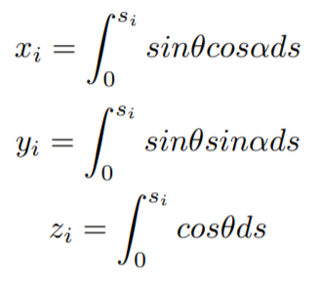
Problem
z
Drag
Y
Terms
Azimuth α.
Inclination θ.
Torque.
Drag.
Measured depth S.
Ture Vertical Depth (TVD).
X
(North)
TVD
Torque
α
Measured
Depth
θ
Motivation
Minimize risk.
Save $M.
Computer science

Slide 4
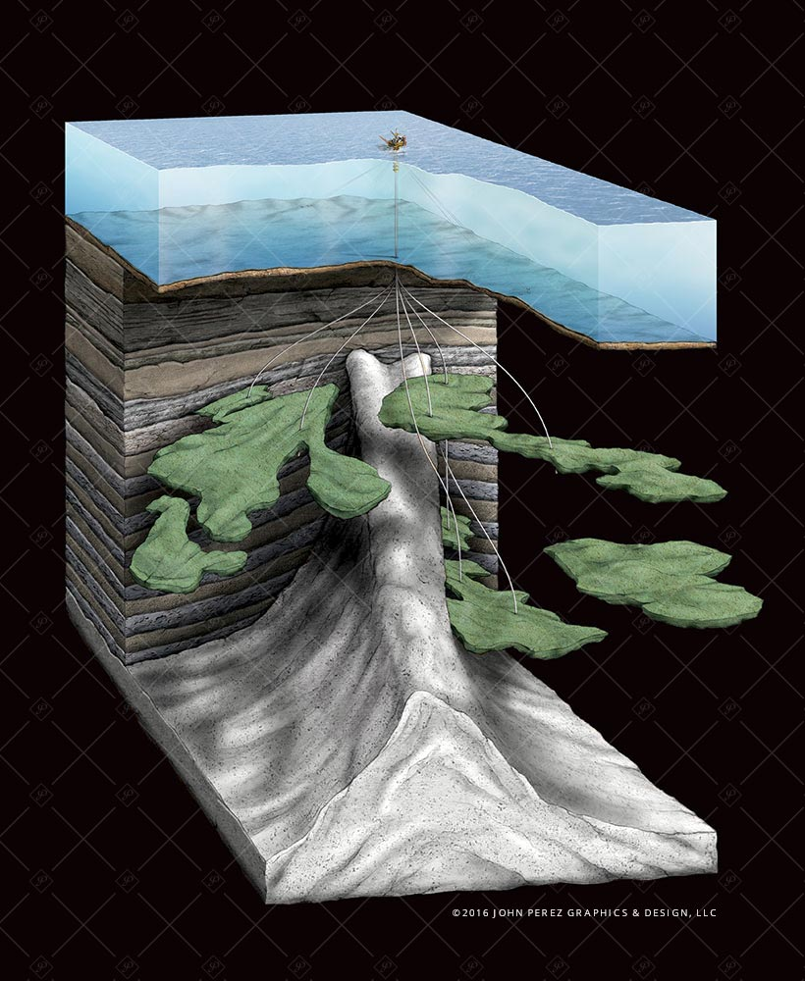
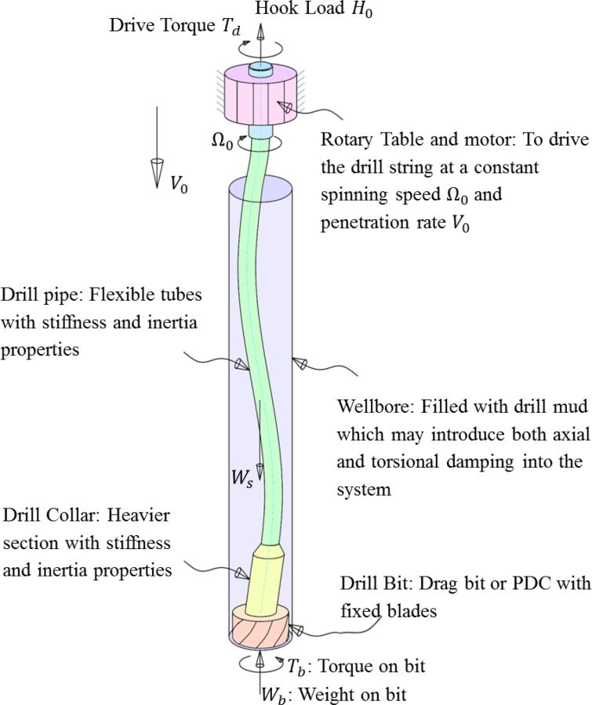
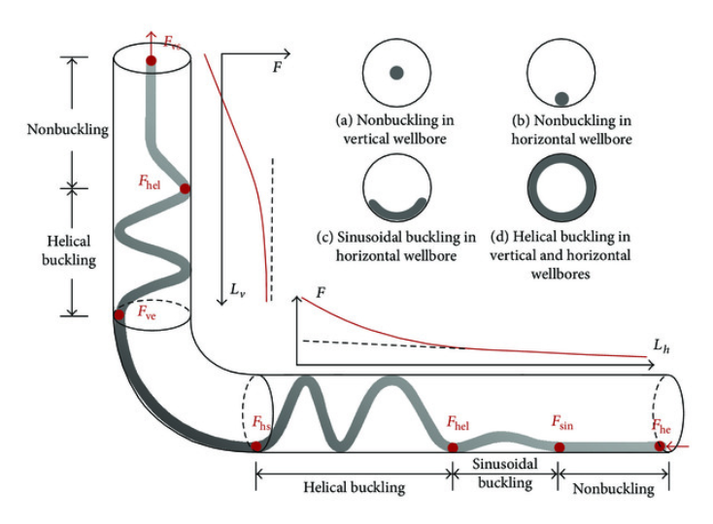
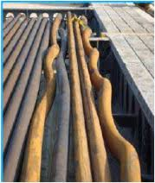
Drilling string buckling
Kilometers long offshore wells
Computer science

Slide 5
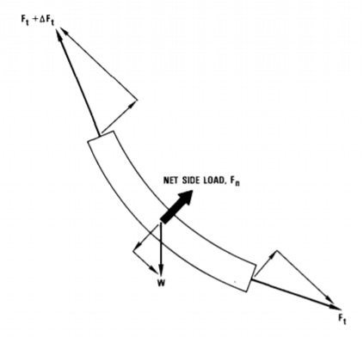

Mathematical Model (original)
Assume that T&D caused by sliding friction force:
Normal contact force
(due to: gravity, tension from curvatures)
Friction coefficient.
The original model:
where, F=friction force
μ=friction coefficient
s=measured depth
W=weight/unit length
Wellbore surface
Computer science

Slide 6
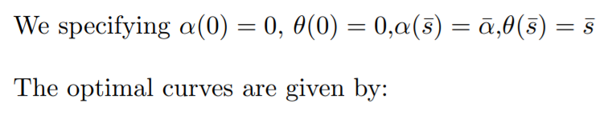
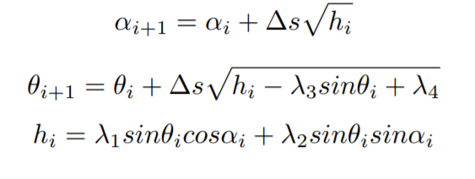
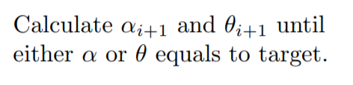
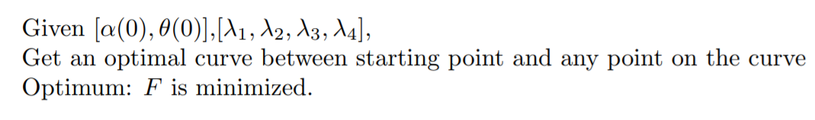
Mathematical Model (by UPRC) con’t
α(0)=0
θ(0)=0
ds θi αi
θ_{N} α_{N}
Computer science

Slide 7

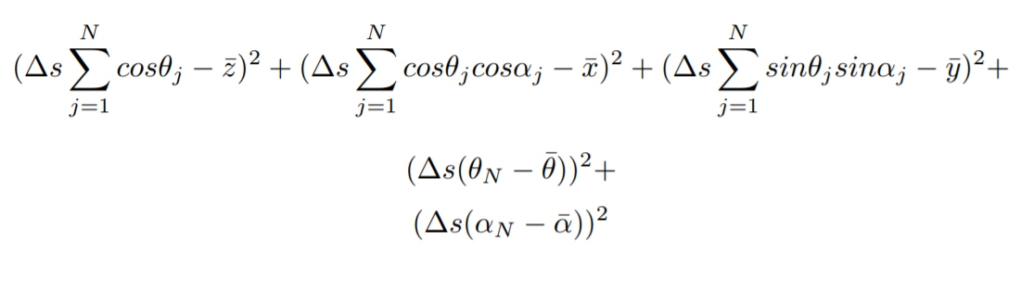
z
Minimization problem
for GA
start
α=0
θ=0
Y
Genotype
X
Generation
Generate curve
Phenotype
Evaluate the deviation from target:
deviation
Fitness
target
Computer science

Slide 8
Thanks!
References (original formulation)
C.A. Johancsik 1984, Torque and Drag in Directional Wells-Prediction and Measurement.
Acknowledgement
Upstream Petroleum Research and Consulting Inc. (UPRC)

